Slide 1


DIABETICS PREDICTION USING ANN
Nithya Santhoshini K
Batch : 263

Slide 2


ABOUT ME
NAME : NITHYA SANTHOSHINI K
EDUCATION: BTECH , CSE 23
BACKGROUND:
Recent B.Tech graduate in Computer Science.
Strong interest in data analytics, software development, and cloud engineering.
WHY DATA SCIENCE:
Passionate about learning and exploring the vast domain of Data Science.
Excited to leverage skills in cloud engineering, data analytics, and software development.
WORK EXPERIENCE:
Currently gaining practical exposure at Innomatics Research Labs.
Eager to further my career and make meaningful contributions in Data Science.

Slide 3
AGENDA
Introduction to Project
Model Building & Accuracy
Objective
Introduction to ANN
Dataset Overview
Model Using ANN
Exploratory Data Analysis
Layers and Compile Parameters
Methodology
Data Preprocessing
Accuracy Comparison (ANN vs ML)
ML Algorithms Overview
Conclusion

Slide 4
Importance of Predicting Diabetes:
Early Detection
Personalized Healthcare
Healthcare Resource Optimization
Cost Savings
Dataset:
Collection of health-related features from various individuals.
Features:
Health indicators (e.g., HighBP, BMI, Stroke)
Lifestyle factors (e.g., Smoking status, Physical activity)
Demographic details (e.g., Age, Income)
Goal:
Develop a model to predict the likelihood of diabetes.
Focus on using both traditional ML models and ANN.
INTRODUCTION TO PROJECT
OBJECTIVE:
Develop a predictive model to estimate the likelihood of diabetes using health and lifestyle factors.
BACK TO AGENDA PAGE
1

Slide 5

OBJECTIVE
Predict diabetes status using a set of health indicators.
Compare the performance of traditional ML models with ANN.
Identify key features contributing to the prediction.
Achieve high accuracy and reliability in predictions.
Understand the impact of feature scaling on model performance.
BACK TO AGENDA PAGE
2

Slide 6

BACK TO AGENDA PAGE
CLASSIFYING DIABETES PREDICTION
Definition: Predicts an individual's risk of developing diabetes, making it a classification problem in machine learning.
Binary Classification: Involves determining if an individual has diabetes (1) or does not have diabetes (0).
Target Variable: Binary with possible outcomes of 0 (non-diabetic) or 1 (diabetic).
Evaluation Metrics: Accuracy, precision, recall, F1 score, and AUC-ROC are key metrics to assess model performance.
Real-World Application: Enables early diagnosis and preventive care, enhancing health outcomes.
3

Slide 7
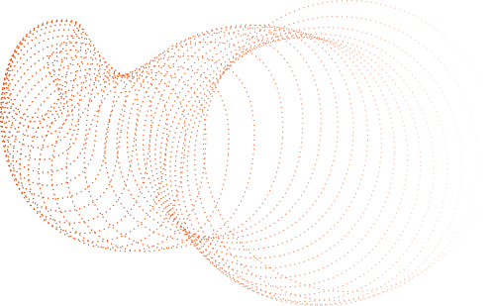
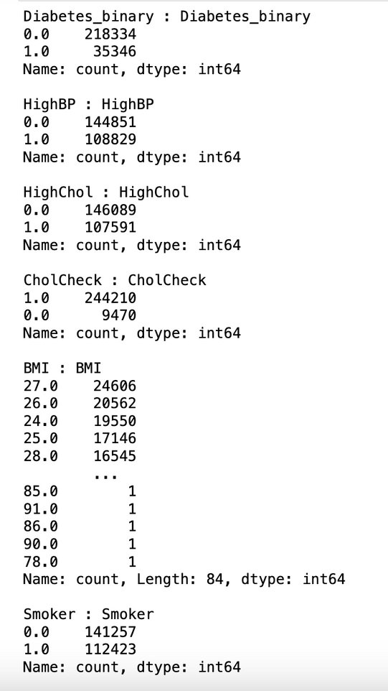
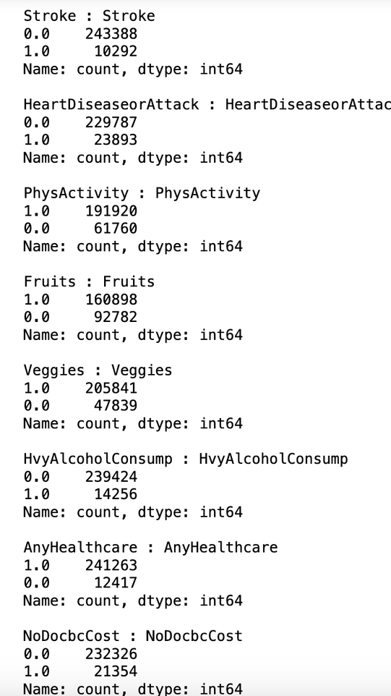
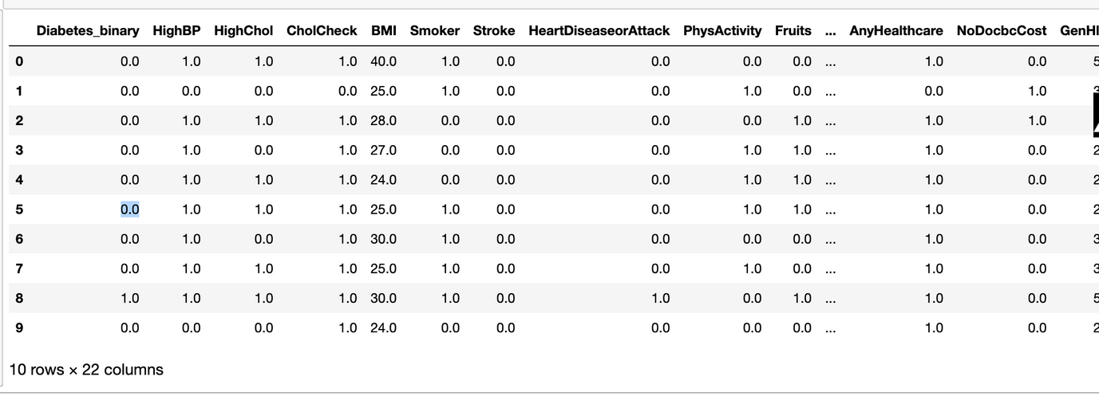
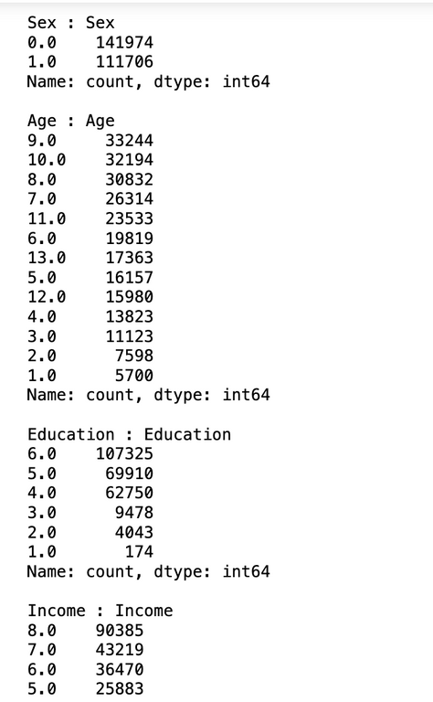
BACK TO AGENDA PAGE
DATASET OVERVIEW
Gender: 0 = female 1 = male
Age: 13-level age category (_AGEG5YR see codebook) 1 = 18-24 9 = 60-64 13 = 80 or older
4

Slide 8
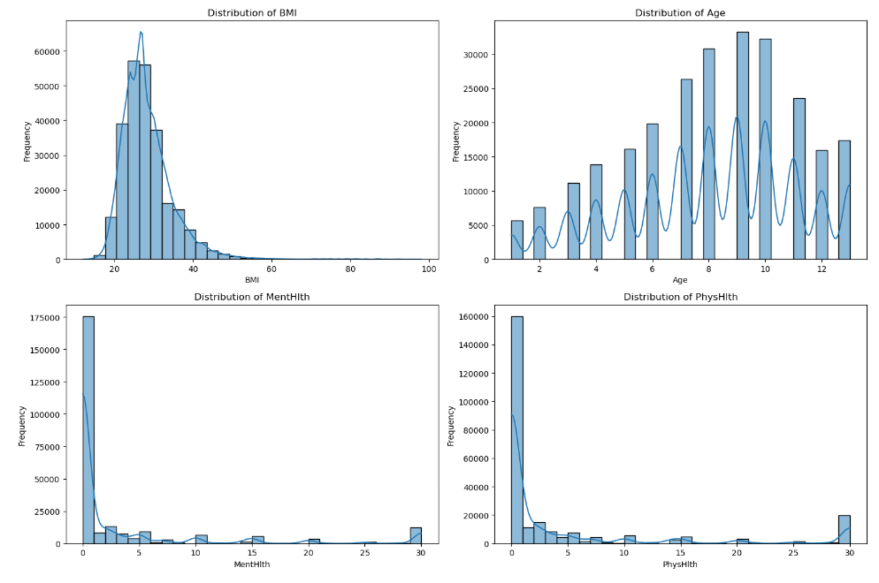
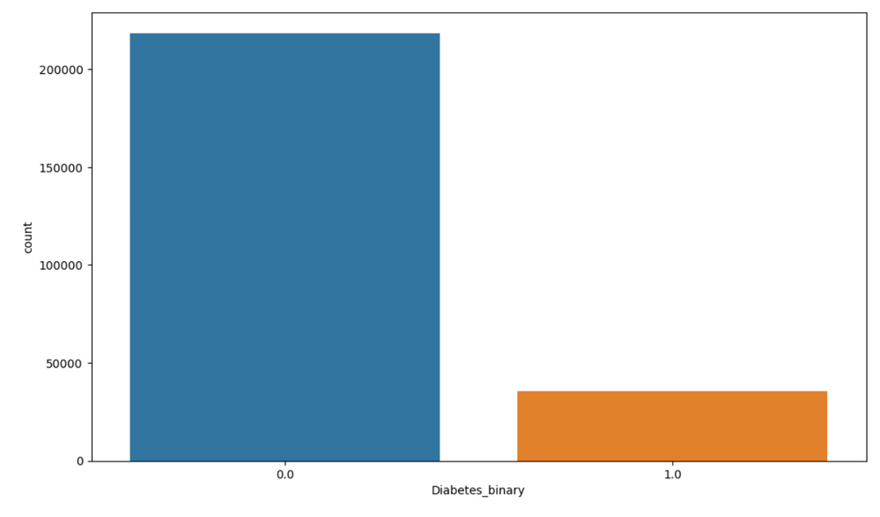
EXPLORATORY DATA ANALYSIS
BACK TO AGENDA PAGE
5

Slide 9
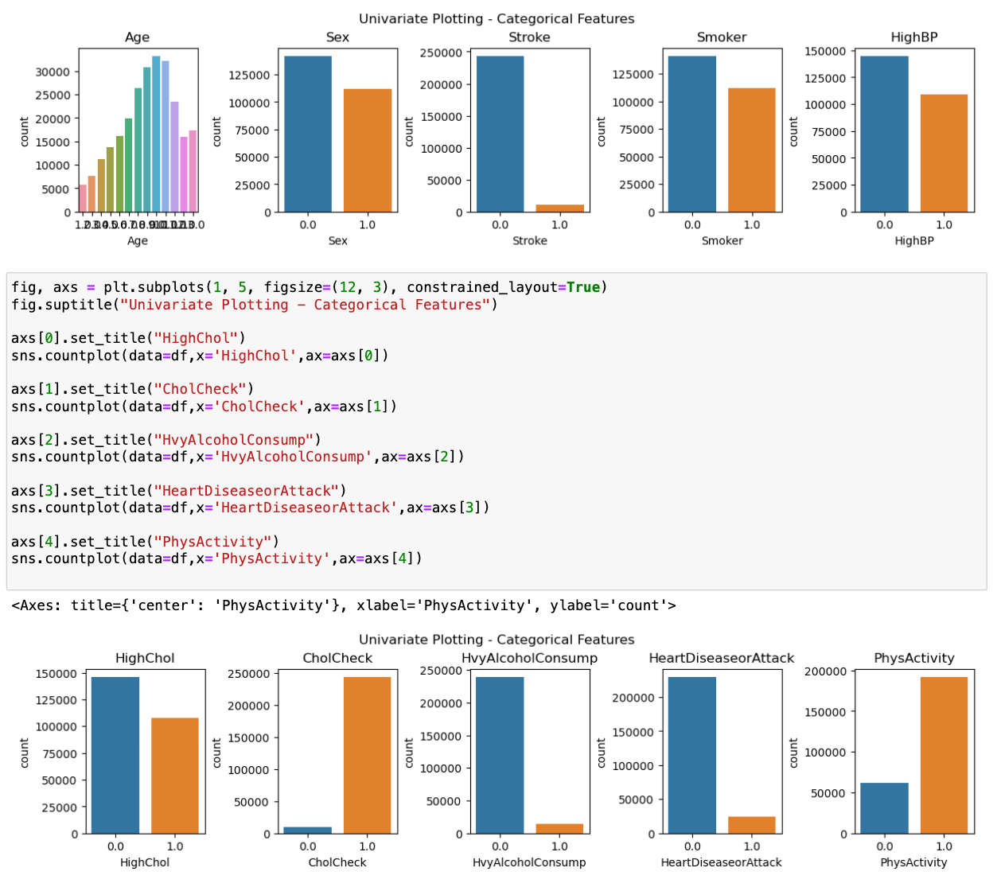

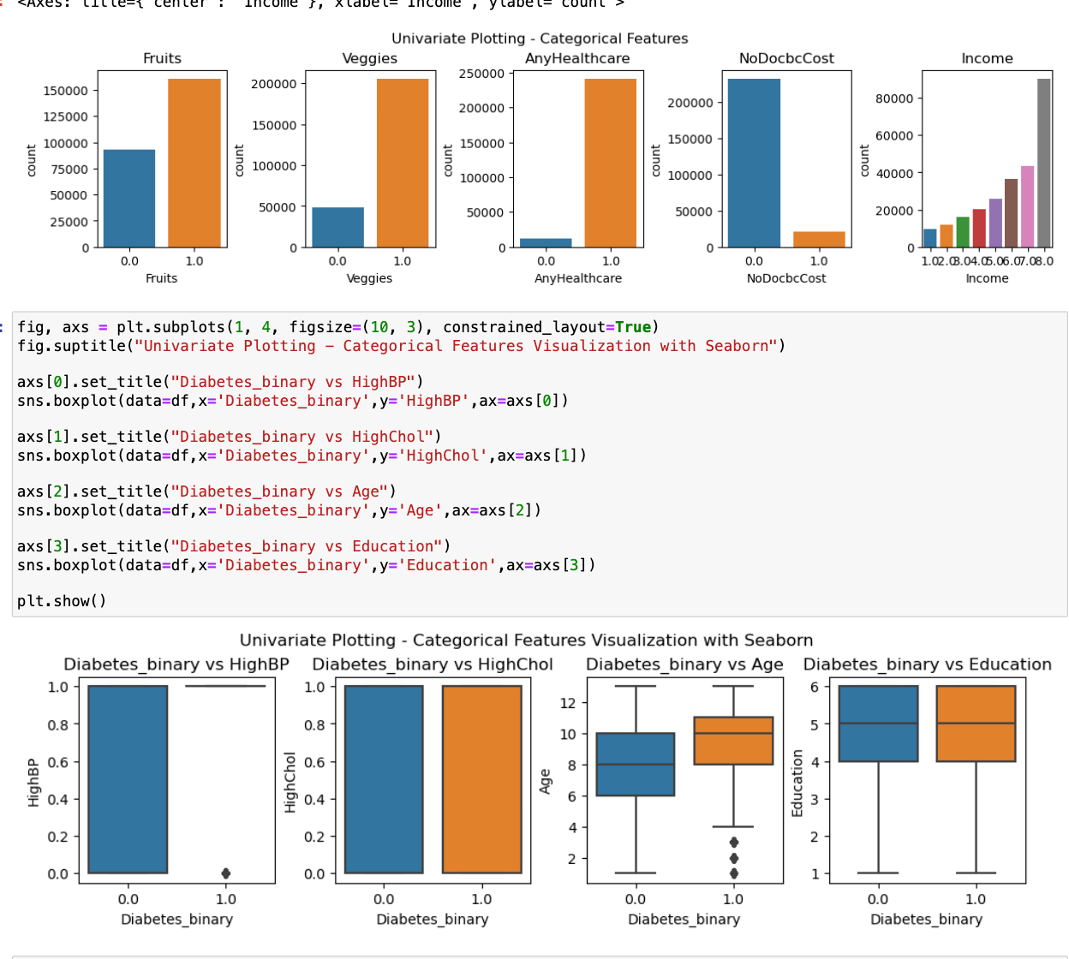
UNIVARIATE ANALYSIS
BACK TO AGENDA PAGE
6

Slide 10
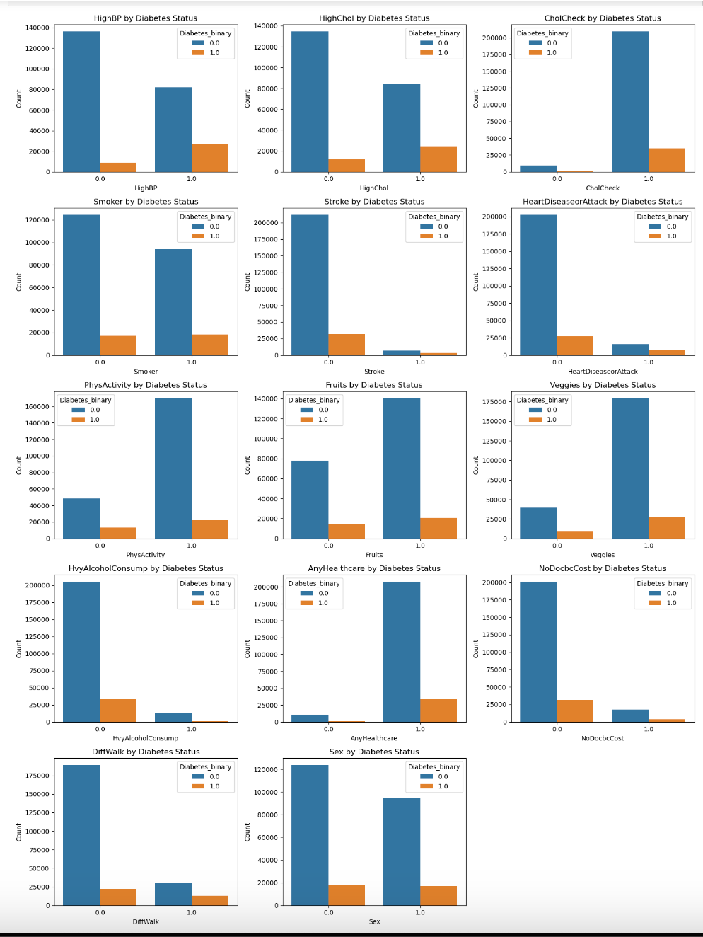
BACK TO AGENDA PAGE
BIVARIATE ANALYSIS
7

Slide 11
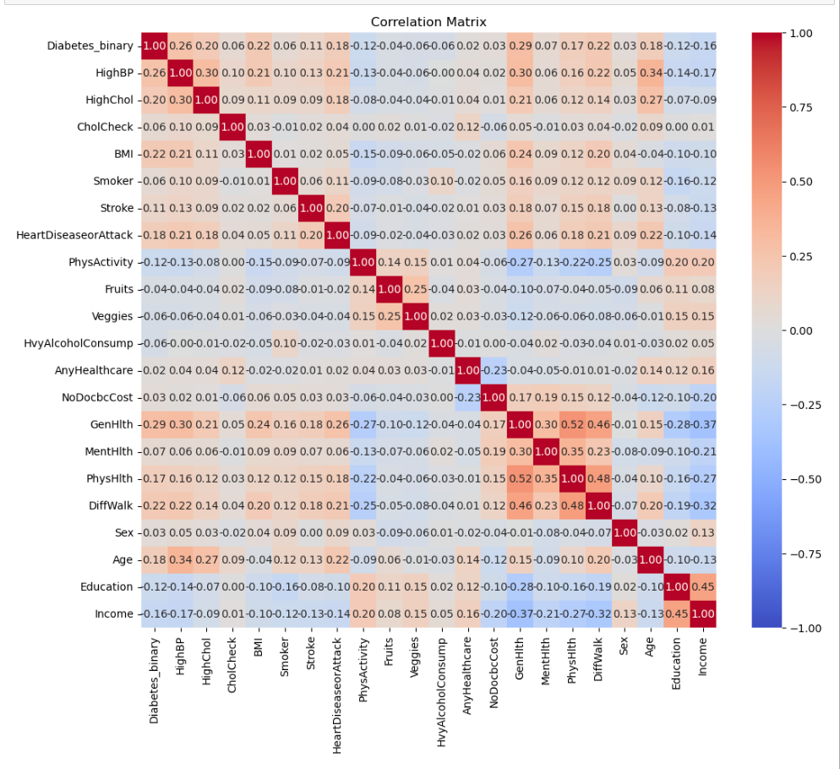
BACK TO AGENDA PAGE
CORRELATION MATRIX
8

Slide 12

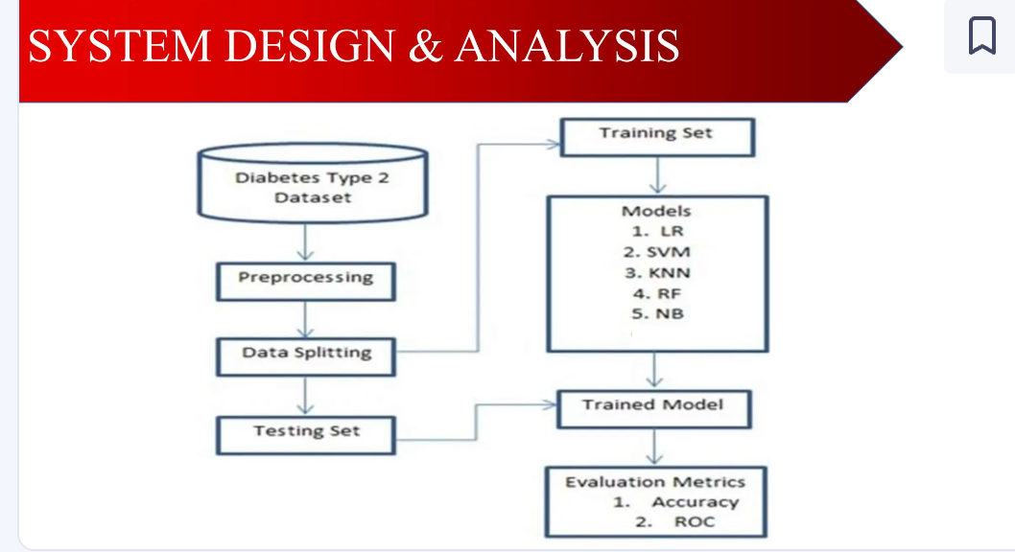
METHODOLOGY OF PROJECT
BACK TO AGENDA PAGE
9

Slide 13

DATA PREPROCESSING
Data preprocessing is crucial for model performance.
StandardScaler used to normalize features.
Ensures features are on the same scale.
Reduces bias in the model training process.
Helps in faster convergence of the model.
BACK TO AGENDA PAGE
10

Slide 14
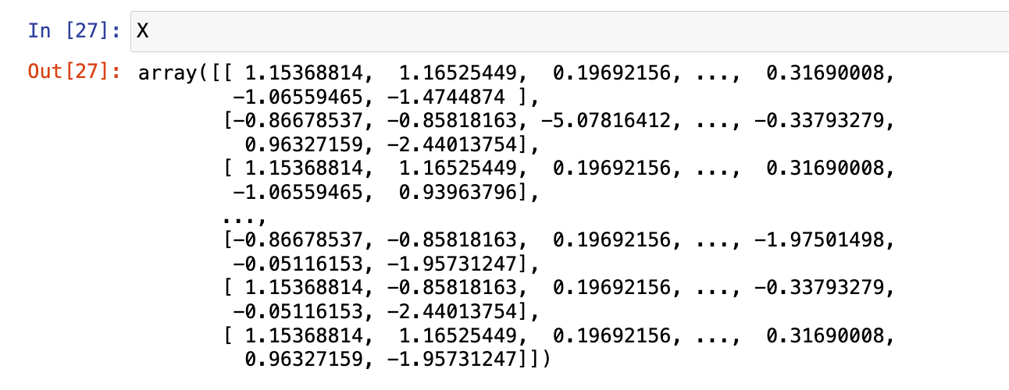
FEATURE SCALING
Used StandardScaler for consistent scaling across features.
Prevents features with larger ranges from dominating the model.
Essential for models like KNN and SVM.
Maintains the distribution of the original data.
Facilitates better model interpretation.
BACK TO AGENDA PAGE
11

Slide 15
ML ALGORITHMS OVERVIEW
Logistic Regression: A fundamental classification technique that models the probability of a binary outcome using one or more predictor variables.
Decision Trees: Splits data into subsets based on input features, forming a tree-like structure for decision-making.
Random Forest: An ensemble method that builds multiple decision trees and combines their outputs to improve prediction accuracy and reduce overfitting.
Support Vector Machine (SVM): Identifies the hyperplane that best separates classes in the feature space.
K-Nearest Neighbors (KNN): A non-parametric method that classifies a data point based on the majority class among its K-nearest neighbors.
BACK TO AGENDA PAGE
12

Slide 16

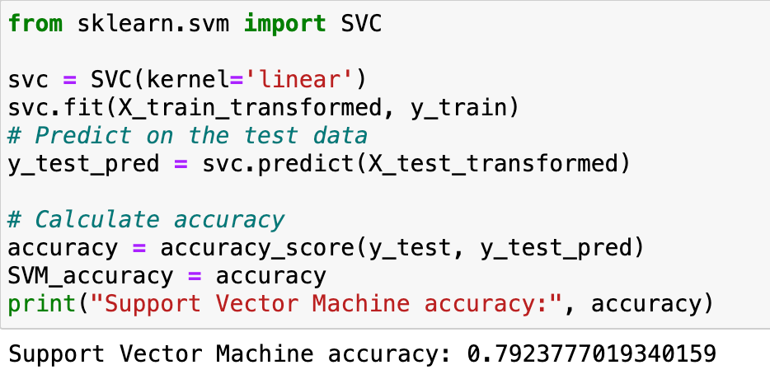
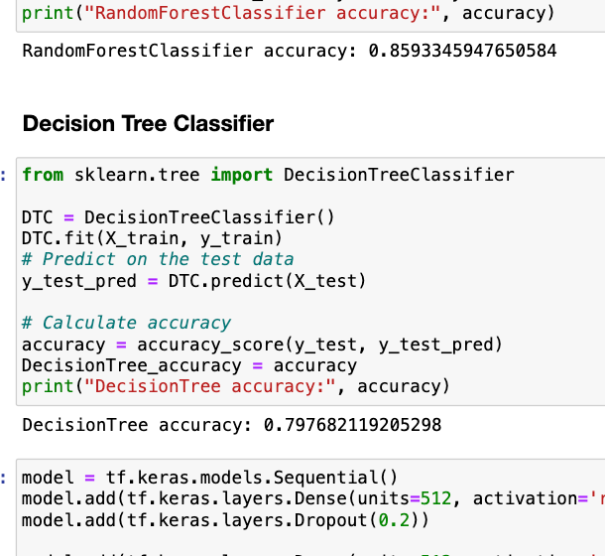
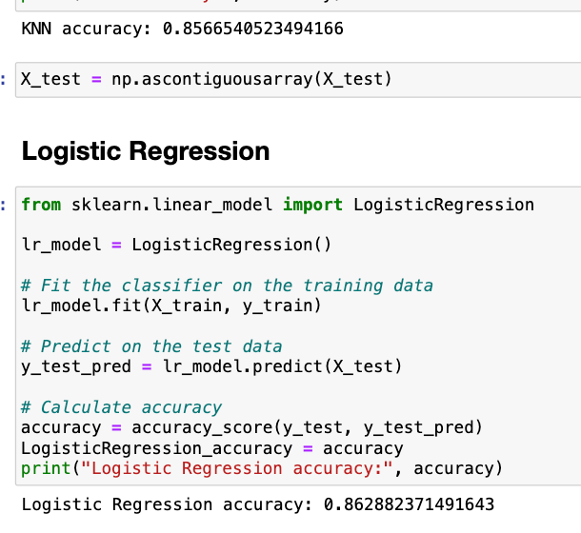
MODEL BUILDING & ACCURACY
Implemented multiple ML algorithms for comparison.
KNN: Provided good results but sensitive to scaling.
SVM: Performed well with balanced data.
RandomForest: Robust, handled variance well.
DecisionTree: Simple but prone to overfitting.
LogisticRegression: Provided accuracy of 86%.
Highest accuracy achieved: 86%.
Models evaluated using accuracy as the primary metric.
BACK TO AGENDA PAGE
13

Slide 17
INTRODUCTION TO ARTIFICIAL NEURAL NETWORKS (ANN)
Definition: Computational models inspired by the human brain's neural network, used for pattern recognition and predictions.
Structure: Composed of an input layer, one or more hidden layers, and an output layer, with nodes (neurons) processing information.
Activation Functions: Nodes use functions like ReLU, sigmoid, or tanh to introduce non-linearity and enable learning of complex patterns.
Training: Trained using backpropagation and optimization techniques (e.g., SGD) to minimize the error between predictions and actual outcomes.
Applications: Versatile in tasks such as image recognition, speech processing, and classification problems like diabetes prediction.
BACK TO AGENDA PAGE
14

Slide 18

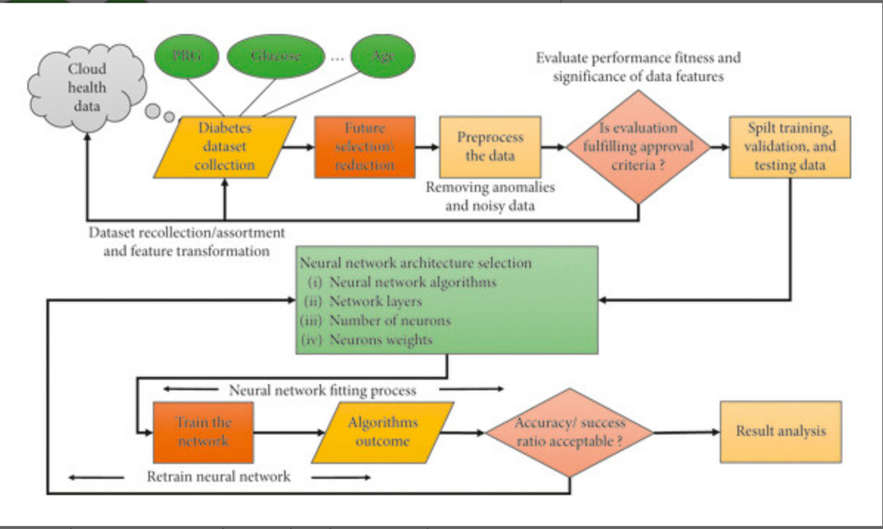
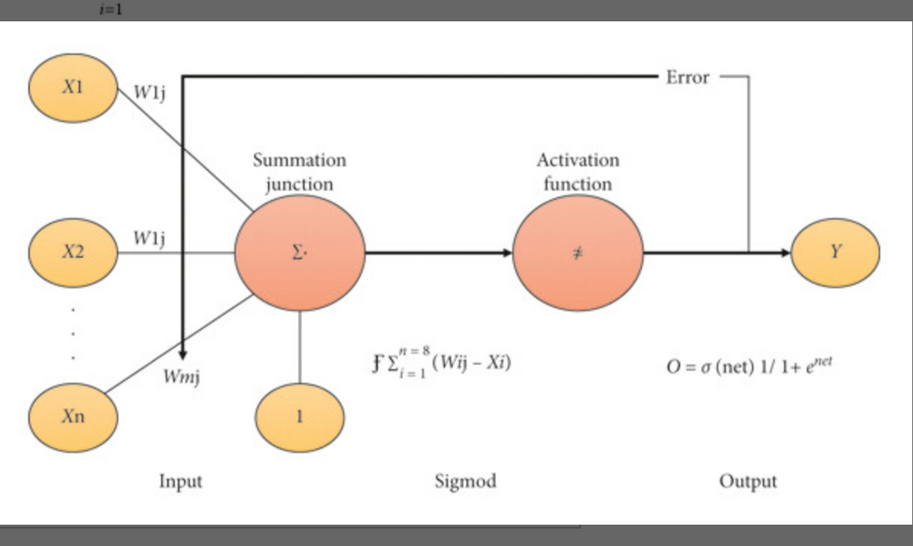
BACK TO AGENDA PAGE
15

Slide 19
Compile Parameters:
Optimizer: SGD (Stochastic Gradient Descent)
Incrementally updates model parameters using small data batches to minimize the loss function.
Function: Adjusts weights during training to help the model converge efficiently.
Loss Function: Binary Cross-Entropy
Measures the difference between predicted probabilities and actual binary labels.
Function: Guides model training by penalizing incorrect predictions in binary classification tasks.
Metrics:
Accuracy - for performance evaluation.
MODEL USING ANN
Designed an ANN to tackle non-linearity in data.
Model architecture: 3 Dense layers with Dropout.
Achieved 87% accuracy similar to traditional ML models.
Further tuning required for potential improvements.
BACK TO AGENDA PAGE
16

Slide 20

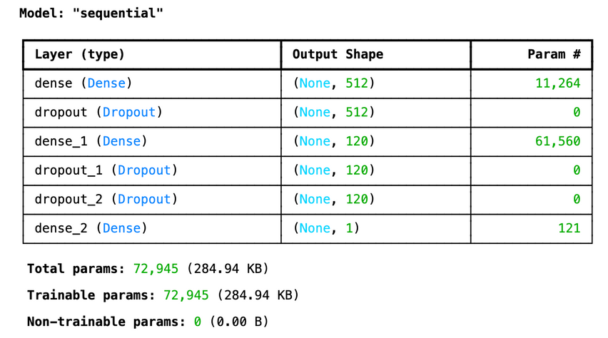
LAYERS & COMPILE PARAMETERS
Layer 1: | Dense (512 units) with ReLU activation
Layer 2: | Dense (120 units) with ReLU activation, followed by Dropout.
Layer 3: | Dense (1 unit) with Sigmoid activation.
BACK TO AGENDA PAGE
17

Slide 21
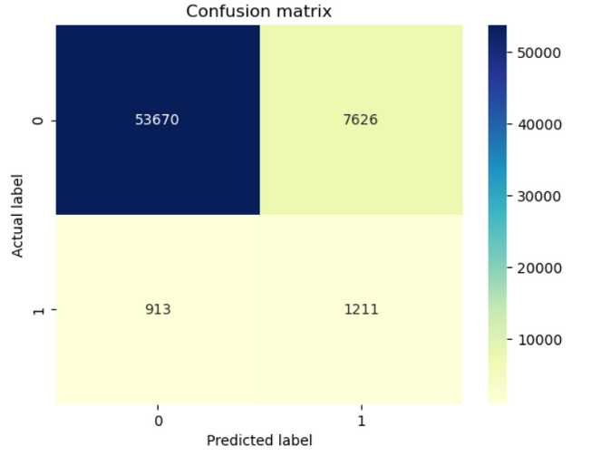
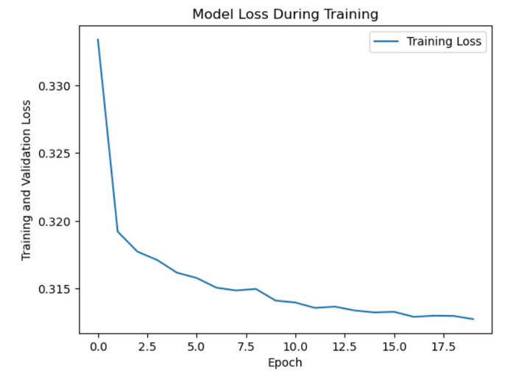
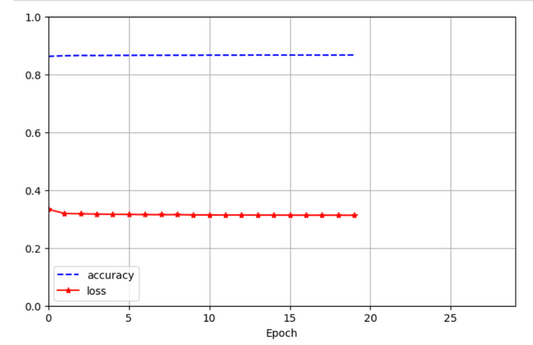
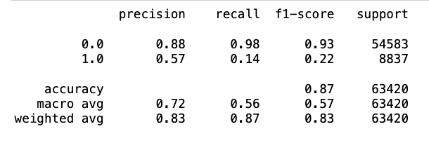
BACK TO AGENDA PAGE
18

Slide 22
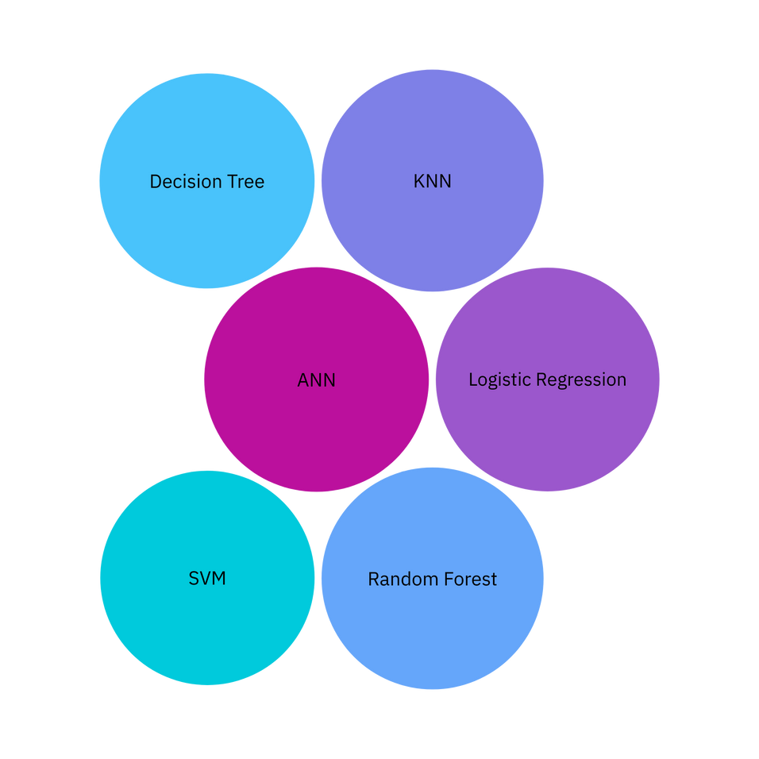
ACCURACY COMPARISON (ANN VS ML)
ANN model achieved 87% accuracy, matching traditional ML models.
Slight variations observed in performance across different runs.
ANN showed better adaptability with more data.
ML models were faster to train but less flexible.
ANN holds potential for future improvements.
BACK TO AGENDA PAGE
19

Slide 23
FUTURE ENHANCEMENTS
Feature Engineering: Creating additional or derived features to improve model performance by providing more relevant information.
Hyperparameter Tuning: Fine-tuning model parameters to enhance accuracy and prevent overfitting.
Data Augmentation: Gathering more diverse and comprehensive data to improve model generalization and robustness.
Advanced Models: Exploring sophisticated models like deep learning techniques or ensemble methods to increase prediction accuracy.
Real-Time Predictions: Integrating the model into a real-time system for dynamic and timely diabetes risk assessments.
User Interface: Developing a user-friendly application or dashboard to make predictions and insights easily accessible to end-users.
BACK TO AGENDA PAGE
20

Slide 24
BACK TO AGENDA PAGE
CONCLUSION
Achieved 87% accuracy using both ML models and ANN.
Feature scaling played a crucial role in model performance.
ANN demonstrated potential for better adaptability.
Future work: Further tuning of ANN, explore advanced architectures.
Overall, project provided valuable insights into diabetes prediction.
21

Slide 25
BACK TO AGENDA PAGE
THANK YOU
https://www.linkedin.com/in/nithya21966/

